Slide 1
Project 3 Applied Data Science
Image Classification using CNN
Group 1:
Aakanksha Agarwal
Lichun He
Kexin Tang
Kaimin Wang
Xinran Wang
Jiaxin Yu

Slide 2
Different Models - Model 1
Model | Runtime | Training Loss | Training accuracy | Validation Loss | Validation Accuracy
MobileNetV2 | 799 seconds | 2.1386 | 29.03% | 1.5675 | 63.76%
ResNET | 9,291 seconds | 2.1738 | 24.68% | 1.8544 | 45.76%
CNN | 730 seconds | 2.1365 | 26.76% | 1.6578 | 54.94%
Vision Transformer | 43,550 seconds | 0.4636 | 17.51% | 2.7854 | 43.86%

Slide 3
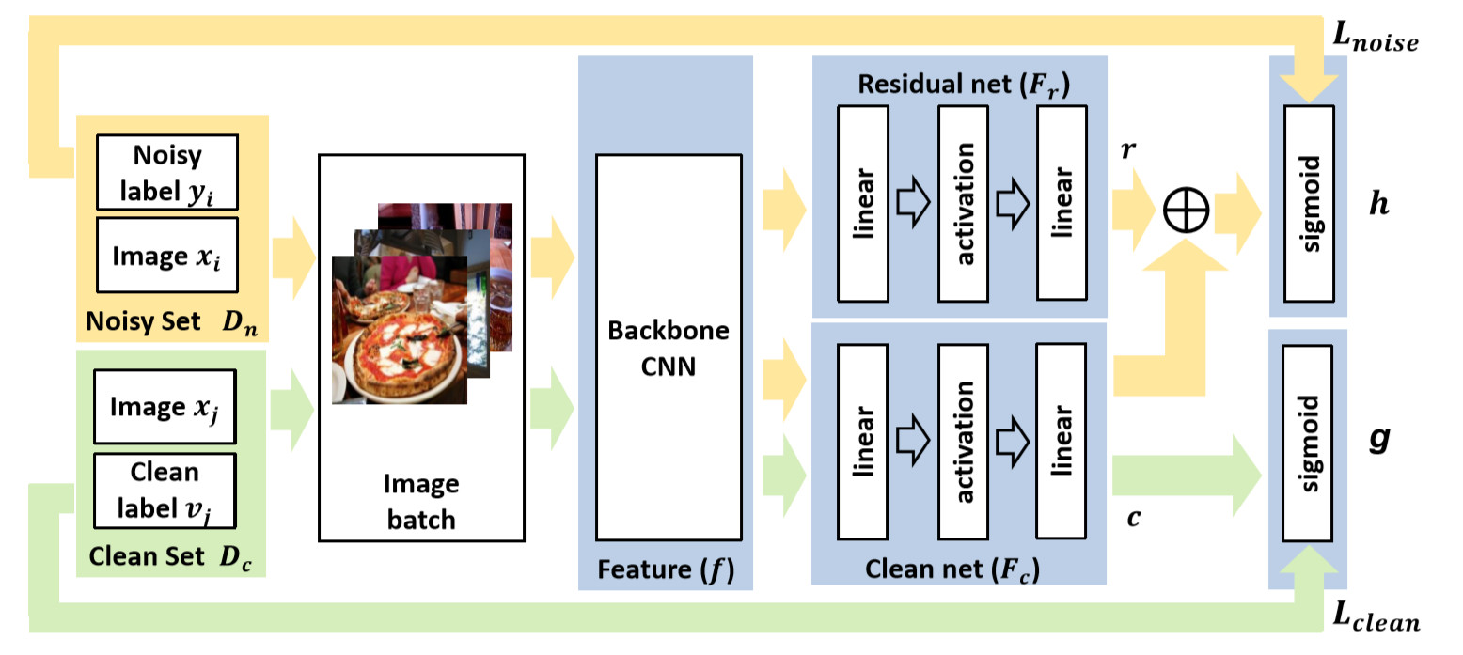
Model 2 Implementation
Implemented the Paper - Weakly Supervised Image Classification through Noise Regularization [Link]
Also tried to implement VGG16 for Model 2 decided against it due to long processing time and lesser accuracy.
Fig 1:
Approach Proposed in the paper.
Due to multiple label classification, instead of the final sigmoid layer we use softmax

Slide 4
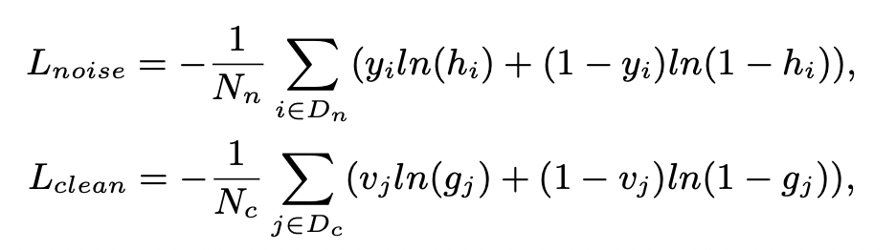

Model 2 Continuation
h and g are trained with binary cross-entropy loss, where h is supervised by noisy label y_i for all samples i in D_n, while g is supervised by the clean label v_j for all samples i in D_c.
L_noise = the loss of h
L_clean = the loss of g
The overall objective during the network training:
Where W denotes the parameters of the network and alpha denotes the trade-off parameter between two losses.

Slide 5
Test set predictions
Runtime of all Models predictions:
Models | Runtime
Baseline | 2 seconds
Model 1 | 369 seconds
Model 2 | 359 seconds

